Slide 1
ANALYSIS OF ROAD ACCIDENTS
Data Analysis And Visualization
CSE – 2015
Review 1 PPT
Presented By :
GANA N H 20211IST0025
MUSKAN ALI 20201IST0050

Slide 2
CONTENTS:
Introduction
Annual Report
Tools Used
Implementation
Conclusion

Slide 3
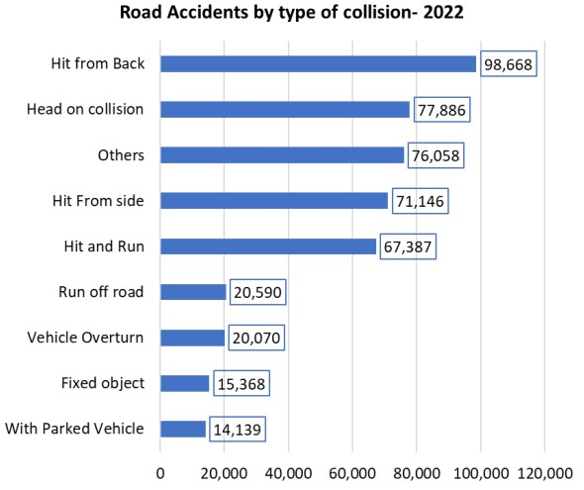
ANNUAL REPORT:

Slide 4
TOOLS USED:
Software:
Google Colab: Colaboratory allows us to write and execute Python codes in our browser.
Libraries:
NumPy
Pandas
Seaborn
Matplotlib
Database: Road Accidents

Slide 5
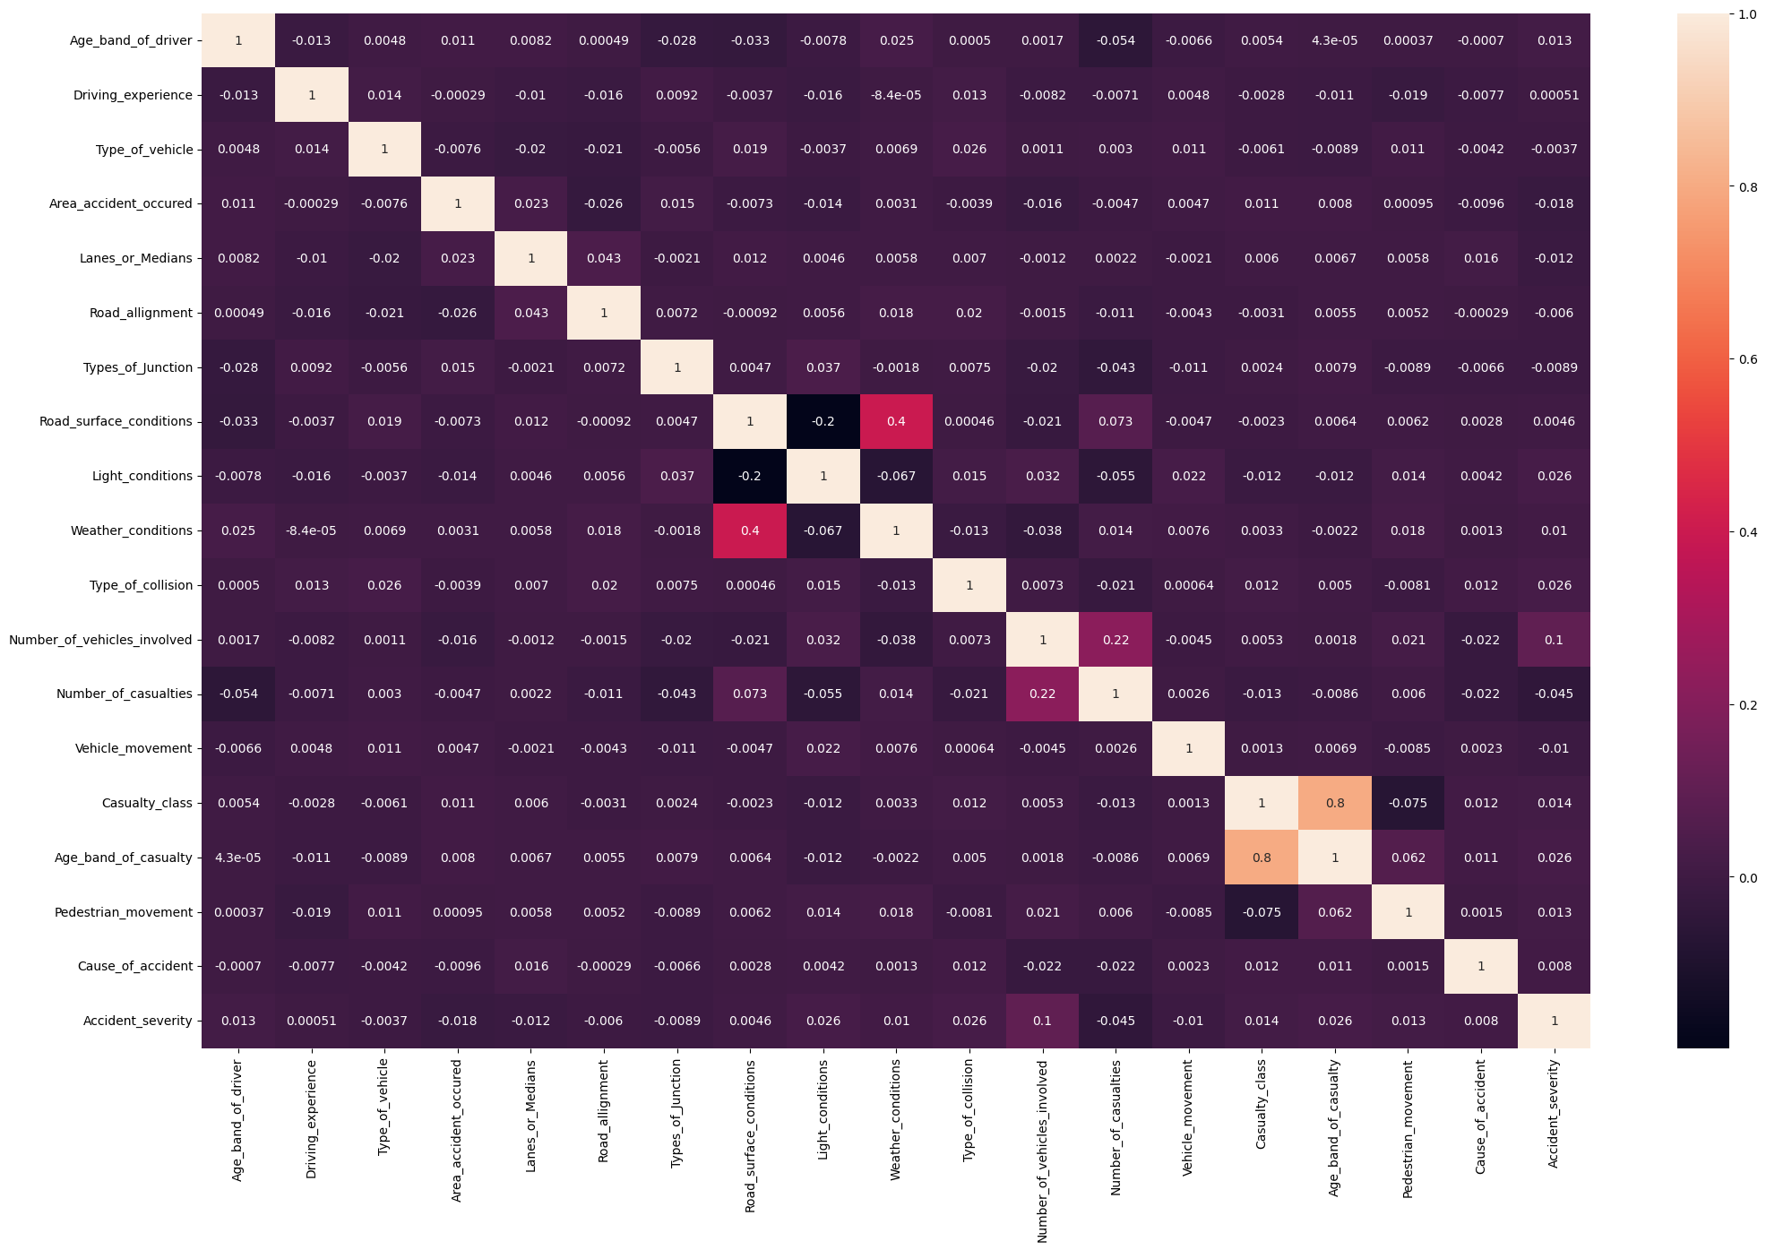

Slide 6
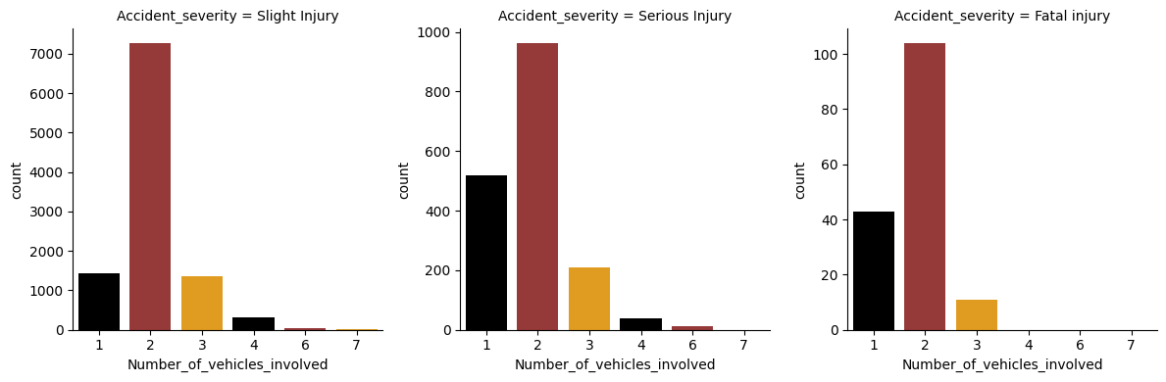

Slide 7
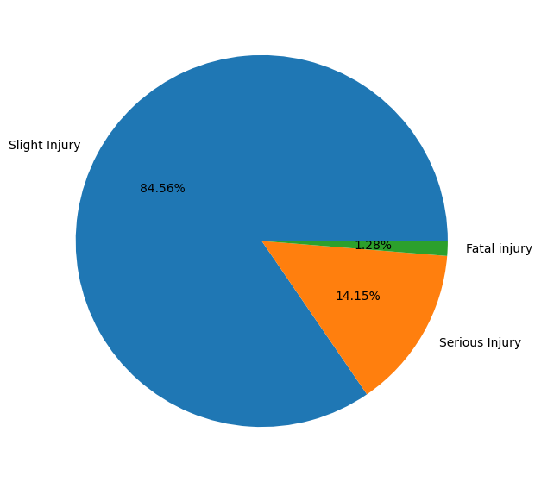
IMPLEMENTATION:

Slide 8
CONCLUSION:
Analyzing and visualizing road accident
data provides valuable insights for
enhancing road safety measures. By
leveraging data-driven approaches, we can
work towards reducing the incidence and
severity of road accidents, ultimately saving
lives and improving public safety.

